Slide 1



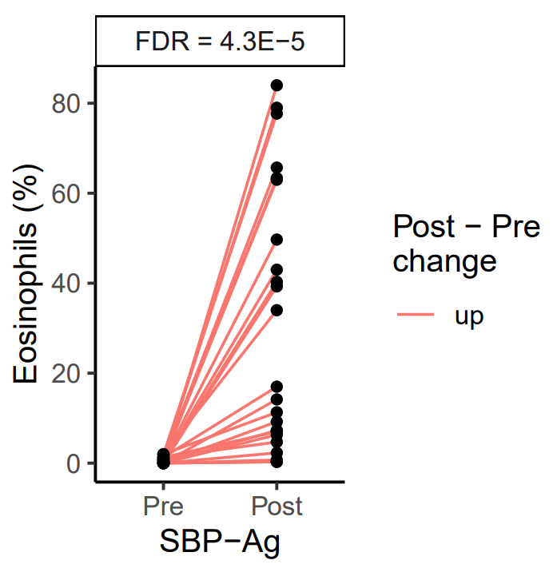
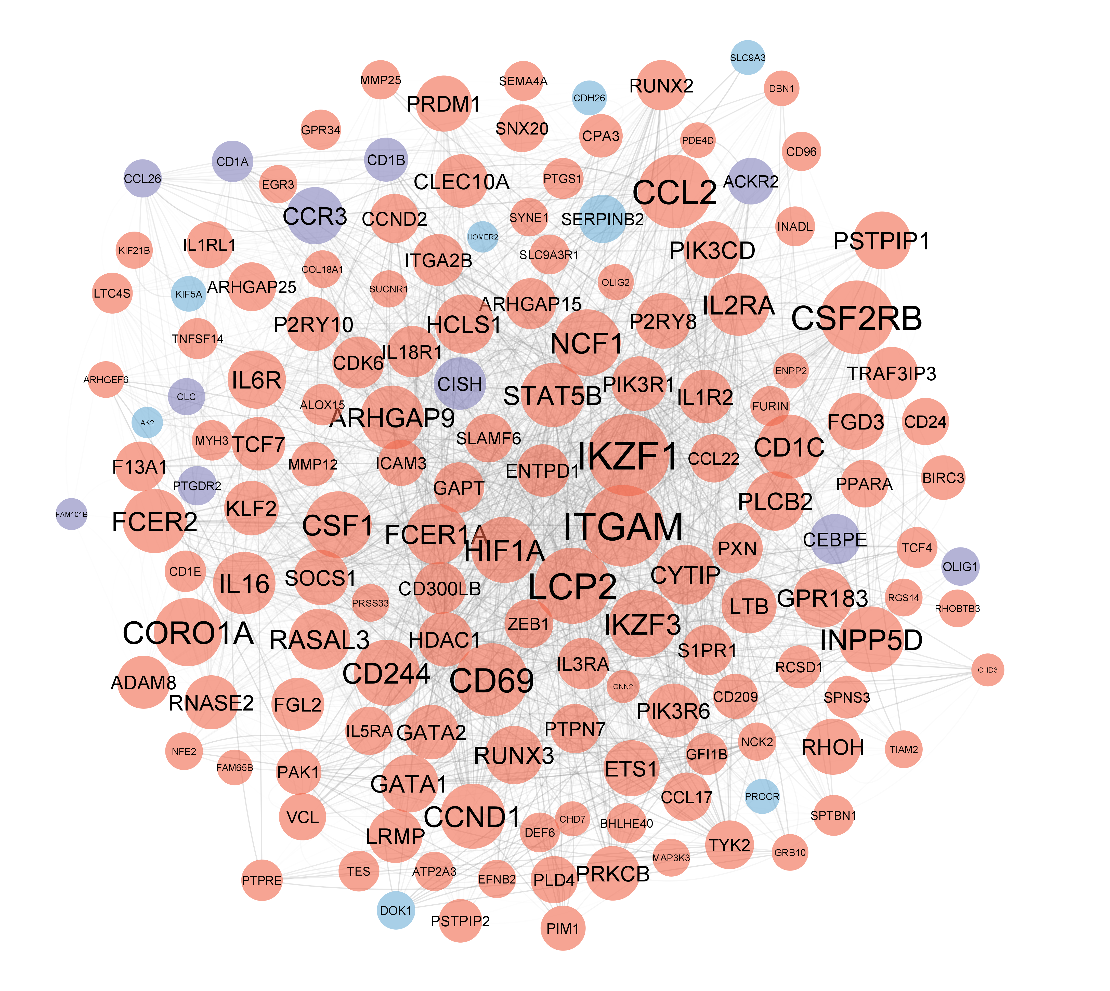

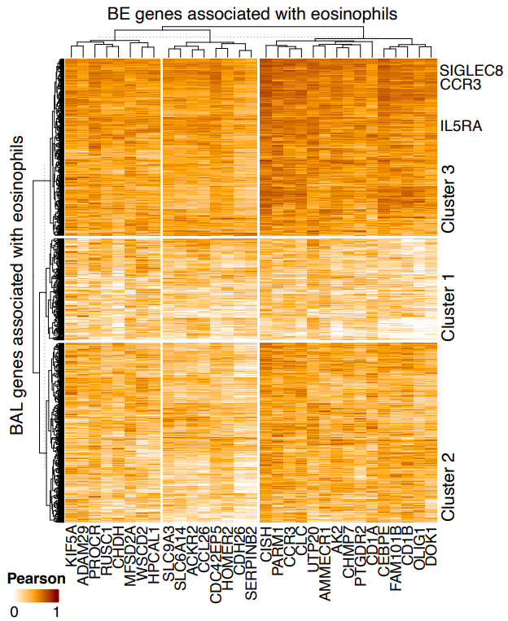
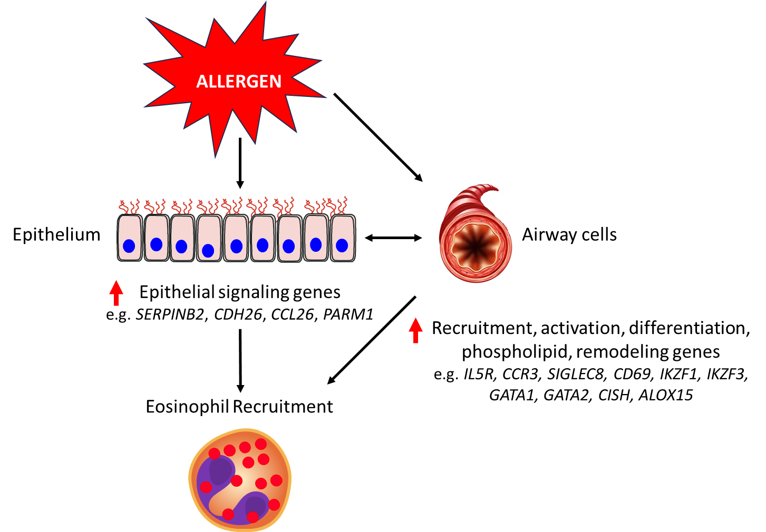
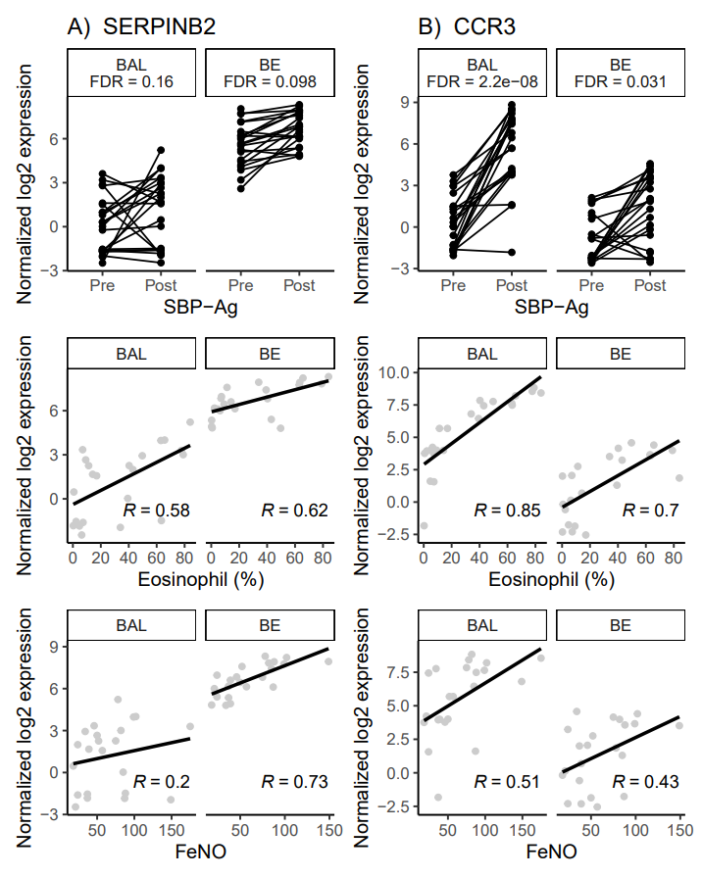
Regulation of the recruitment of airway eosinophils in asthma
W. W. Busse¹, M. Rosenkranz¹, S. Esnault¹, N. Jarjour¹, L. Delinger¹, K. Dill-McFarland², M. C. Altman^{2,3}
AsthMatic Inflammation and Neurocircuitry Activation
¹Departments of Medicine and Psychiatry, University of Wisconsin School of Medicine and Public Health, Madison, WI;
²University of Washington Department of Medicine, Seattle WA; ³Benaroya Research Institute Systems Immunology Division, Seattle, WA
Introduction
Methods
Results
Airway inflammation contributes to the pathophysiology of asthma and results from complex and interactive processes following an environmental provocation. The recruitment and activation of eosinophils in the airway is a major contributor to airway inflammation in asthma. Central to the development of eosinophilic inflammation is activation of the airway epithelium and resident and recruited airway cells. There is limited information on the molecular regulation of eosinophil recruitment in asthma and the relative contribution of epithelial airway cells in these processes.
SBP-Ag provoked a significant but variable increase in BAL EOS (post: 31 +/- 29% vs pre 0.65 +/- 0.69, p=4.3E-5)
Cell association
BAL and BE
BAL only
BE only
Segmental bronchial provocation with allergen (SBP-Ag) was used to provoke airway inflammation in 23 subjects with mild asthma: age = 26 ± 6.7 years; 52% female; baseline FEV1 (% predicted = 91 ± 11%); and FeNO = 46 ± 29 ppb). SBP-Ag provides opportunities to directly investigate the airway response to an Ag provocation by characterization of eosinophil recruitment and activation in bronchial epithelial cells from brushings and airway luminal cells obtained by lavage. This approach allowed us to determine the effects of an airway allergen challenge on the expression of gene activation in key airway cells – epithelium and mononuclear cells and to determine the molecular contributions of eosinophil recruitment to the airway. Bronchoalveolar lavage (BAL) associated cells and bronchial epithelial brushings (BE) were obtained pre- and post (48 hours)-SBP-Ag for RNA-sequencing (RNA-Seq) analysis (n=21 with complete data). Differential gene expression was determined using linear models in BAL and BE samples separately. Significant genes were defined as those that significantly changed after SBP-Ag and were associated with BAL EOS and/or FeNO levels post SBP-Ag samples (FDR < 0.1). Associations among BAL and BE genes was assessed using pairwise Pearson correlations and patterns among sample types were determined by hierarchical clustering. This approach allowed for the identification of patterns of differential gene expression of BE and BAL cells associated with EOS recruitment and/or FeNO production in the airway after SBP-Ag challenge.
Objectives
31 BE genes significantly upregulated by SBP-Ag and including epithelial immune signaling molecules were highly correlated with 1324 BAL genes also upregulated by SBP-Ag. All of these genes showed significant correlation with the increase in eosinophils to the airway after SBP-Ag.
To use allergen provocation to activate airway inflammation in asthma and determine the molecular contribution of epithelial and airway cells to eosinophil recruitment.
The gene-gene interaction network of core BE and BAL genes associated with the increase in eosinophils after SBP-Ag.
Graphical Summary
Conclusions
Our results identify important interactions between the BE and BAL cells in response to SBP-Ag that relate to the recruitment of EOS to the airway.
Notably these results help identify those specific factors relating to EOS recruitment. Moreover, these findings also suggest that BE activation may initiate the EOS recruitment process which is then further enhanced by mobilized BAL cells and contributed to airway inflammation as measured by a greater generation of FeNO (post- pre- 46 ± 29 ppb vs 65 ± 40 ppb [4.1 E-5]).
As example, shown are the expression levels of SERPINB2 and CCR3, representative examples of BE and BAL genes significantly upregulated by SBP-Ag and correlated with the percent of BAL eosinophils.
Funded by NIAID/NIH …

